Slide 1
PILOT STUDENTS – Oct/Nov 2015 (this applies to you)
(1) When you see an instruction to upload something, upload it to your desktop. If faculty needs it, they will ask for it.
(2) Contact info is in the FAQ for any issues.
NoSQL Databases
Module 5
Graph Databases
Notes:
Note to Narrator: Do NOT narrate any words, acronyms, or anything enclosed in ( ) that’s in the narrative script.

Slide 2

Course Objectives
At the end of the course, you should be able to:
Describe the data model of a graph database, and understand how it differs from a traditional RDBMS data model
Interchangeably use properties and labels of graphs to define additional metadata that describes graph nodes
Use the Neo4j database and basic Cypher statements to create, query and return relationships about data in a graph database
Understand the code API’s, architecture and limitations of Neo4j and graph databases in general
Notes:
Narrative:

Slide 3
This Week’s Outline
Introduction to Graph Databases
History of technology
Major release schedule
How this technology differs from traditional data architecture and Hadoop specifically
Major vendors
Neo4j
Limitations and Considerations
Cost of vendor(s) technology / tools
What are the key decision points driving a use case for this technology? (Cost, security, functionality, capability, performance, etc.)
What is this technology NOT good for
Beyond Neo4j and alternate graph solutions
Conclusion
Notes:
Narrative:

Slide 4
Introduction to Graph DBs

Slide 5
What is a Graph?.
A graph is just a collection of vertices and edges—or, in less intimidating language, a set of nodes and the relationships that connect them.
Graphs represent entities as nodes and the ways in which those entities relate to the world as relationships.
Graphs are very useful in understanding data that is interrelated
Gartner has identified five types of graphs in the business world right now:
Social
Intent
Consumption
Interest
Mobile
Mark Zuckerberg
Follows
Follows
Follows
Follows
Warren Buffett
Bill Gates
Follows
Notes:
For example, Twitter’s data is easily represented as a graph. In the figure, we see a small network of followers. The relationships are key here in establishing the semantic context: namely, that Mark follows Bill, and that Bill, in turn, follows Mark. Mark and Warren likewise follow each other, but sadly, although Warren follows Bill, Bill hasn’t (yet) reciprocated.

Slide 6
Simple Twitter Example as a Graph
Social media data is easily represented as a graph
The figure on the right shows a small network of followers
The relationships between users are key in establishing semantic context:
Mark follows Bill → Bill in turn follows Mark → Mark and Warren likewise follow each other
Bill does not follow Warren, graph relationships are not always bidirectional
Mark Zuckerberg
Follows
Follows
Follows
Follows
Warren Buffett
Bill Gates
Follows

Slide 7
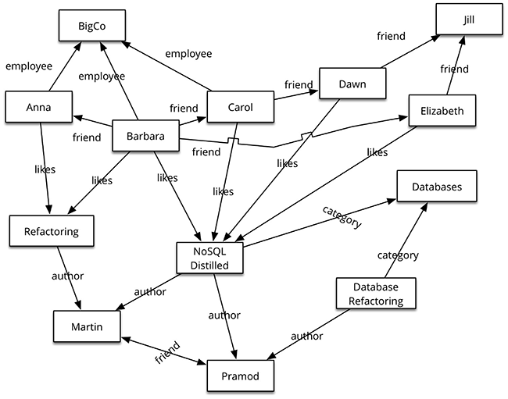
Graph DBs - Overview
Graph databases allow you to store entities and relationships between these entities.
Entities are also known as nodes, which have properties.
A node is an instance of an object in an application
Nodes are organized by relationships which allow you to find interesting patterns between the nodes.
Relationships are known as edges that can also have properties.
Edges have directional significance; The organization of the graph lets the data to be stored once and then interpreted in different ways based on relationships.

Slide 8
Graph Structure in RDBMS
RDBMS is best suited for a single kind of relationship
“Who is my manager" is a common example:
Select * from Company where title = ‘manager’ and user_id = my_name
Adding another relationship to the mix usually means a lot of schema changes and data movement or inefficient query statements:
Select * from Company where title = ‘manager’ and title = ‘supervisor’ and user_id = my_name
This is not the case with graph databases, where one entity or person can be related to another entity in a number of ways without changing the core data model

Slide 9
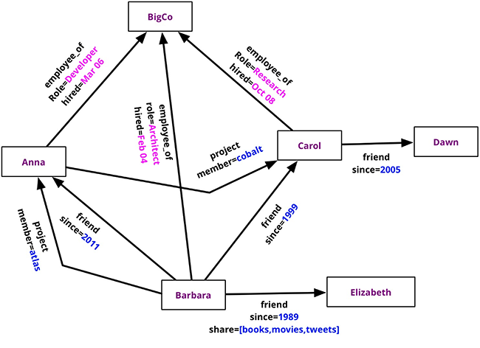
NoSQL Graph Structured Databases
Nodes have different types of relationships and can have secondary relationships
In graph databases, traversing the joins or relationships is very fast.
The relationship between nodes is not calculated at query time but is actually persisted as a relationship.
Traversing persisted relationships is faster than calculating them for every query
Value of graph databases is derived from well-defined relationships
Since there is no limit to the number and kind of relationships a node can have, they can all be represented in the same graph database.
Notes:
Nodes can have different types of relationships between them, allowing you to both represent relationships between the domain entities and to have secondary relationships for things like category, path, time-trees, quad-trees for spatial indexing, or linked lists for sorted access.
Relationships are first-class citizens in graph databases; most of the value of graph databases is derived from the relationships. Relationships don't only have a type, a start node, and an end node, but can have properties of their own. Using these properties on the relationships, we can add intelligence to the relationship—for example, since when did they become friends, what is the distance between the nodes, or what aspects are shared between the nodes. These properties on the relationships can be used to query the graph.

Slide 10
Developing a Graph Data Model from RDBMS
Table = Edge/ Label
Row = Node
Category
Store
Product
PART OF
PRODUCT
SOLD
Order
SUPPLIES
Supplier

Slide 11
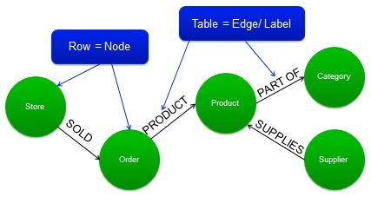
How Does the Graph Data Model Differ from the Relational Data Model?
There are no null values in a graph database. If two elements are not related they implicitly do not have a relationship.
Graph databases describe relationships in greater detail and directly. From the diagram we know a store sold an order directly rather than having to have a foreign key between two tables.
In graph databases additional metadata about each relationship can be added.
Data can be normalized to be a node instead of metadata if the query patterns require. For example, store city may be metadata but if users query against address often store city can be made a node.

Slide 12
A graph has Nodes, Edges and Labels
Node is a specific row value
Edge is the table/category
Labels describe the relationships between nodes
Nodes
Labels
1
memberOf
memberOf
2
3
Edges

Slide 13
In a Property Graph Nodes and Edges Can Have Properties
community: Digital
1
name: Clara
office: London
role: architect
interests:
[graphs, neo4j]
memberOf
since: 2013
memberOf
since: 2009
name: TJ
office: Philadelphia
role: architect
interests:
[graphs, mozart]
2
3
Properties
A property is a type of metadata associated with a node.

Slide 14
Property Graph: Data Representation
Properties
“Data as Hashmap”
Nodes/Edges
“Data as Graph”
For most implementations
Keys are Strings
Properties are primitives, serialized objects
Typical access pattern
Put+Get, Index lookups
The obvious way to store data!
Differs between implementations
Nodes, Edges might have labels
Edges are (uni-/bi-)directional
Typical access pattern
Graph traversals
The graph way to store data!
What should I use?

Slide 15
Property Graph: Data Representation
Part of your data which could be…
… represented as
Graph
… represented as
Properties

Slide 16
Property Graph: Data Representation
Part of your data which should be…
… represented as
Graph
… represented as
Properties

Slide 17
Property Graph: Data Representation
Part of your data which make actual sense to be…
… represented as
Graph
… represented as
Properties

Slide 18
A Sample Graph with Properties
community: Digital
1
name: Clara
office: London
role: architect
interests:
[graphs, neo4j]
memberOf
since: 2013
memberOf
since: 2009
name: TJ
office: Philadlphia
role: architect
interests:
[graphs, mozart]
2
3

Slide 19
Same Graph – More Graph Nodes, Less Properties
community: Digital
1
memberOf
since: 2013
memberOf
since: 2009
name: Clara
office: London
interests:
[graphs, neo4j]
2
3
name: TJ
office: Philadelphia
interests:
[graphs, mozart]
isA
4
isA
name: architect
New node replaces name related ‘architect’ property

Slide 20
Same Data – More Graph, Less Properties
community: Digital
1
memberOf
since: 2013
memberOf
since: 2009
name: Clara
office: London
2
3
name: TJ
office: Philadelphia
isA
4
isA
name: architect
Shared interest
likes
likes
subset
likes
Interests now as nodes
5
4
6
subset
name: neo4j
name: graphs
name: mozart

Slide 21
Same Data – All Information as Nodes
name: London
name: Philadelphia
community: Digital
5
1
5
office
memberOf
since: 2013
memberOf
since: 2009
office
2
name: Clara
3
isA
4
name: TJ
isA
name: architect
likes
likes
subset
likes
5
4
6
subset
name: neo4j
name: graphs
name: mozart

Slide 22
Displaying Data as Properties or Graph? A Social Network Example:
Properties
Nodes/Edges
name: John
knows: [
Mark,
Lisa,
Susan
]
2
name: John
2
name: Lisa
knows
3
knows
knows
knows
knows
3
name: Lisa
knows: [
John,
Susan
]
5
4
name: Mark
name: Susan

Slide 23
Graph DB Quick Quiz
Q: What is the path of data to look up values called?
-A traversal
Q: Can there be null values in a graph database?
-No! If there is no relationship defined then two entities are not related.
Q: Can edges or relationships have properties?
-Both can have properties! Properties can define a user and properties can define the relationship that user has with another user.

Slide 24
Properties or Graph? User’s Age Example
Properties
Nodes/Edges
name: John
age: 21
2
age: 21
2
3
age: 22
3
name: Susan
age: 21
yearsOld
yearsOld
yearsOld
name: Lisa
name: Mark
age: 21
2
yearsOld
3
name: John
2
3
5
name: Lisa
age: 22
4
name: Mark
name: Susan

Slide 25
Antipattern: Supernodes
Supernodes have an incredibly high degree of connections.
They make traversals hard. Instead of overloading a single node with too many properties, consider breaking it up into multiple nodes.
user_id=0
user_id=1
user_id=2
user_id=3
user_id=4
user_id=5
…
user_id=999999

Slide 26
Best Practices 1
Unless it makes sense, don’t use generic attribute keys. Try to be specific so when users want to query the data they do not get erroneous values.
name | Susan
hobby1 | programming
hobby2 | ruby
popularity | medium
name | John
hobby1 | surfing
hobby2 | guitar
hobby2_since | 2008
popularity | low
name | Lisa
hobby1 | hacking
hobby2 | javascript
hobby3 | angular.js
popularity | high

Slide 27
Best Practices 2
Complex attributes are hard to work with (storage, indexing, …). If attributes become too complicated they will impact query performance. Consider breaking attributes up.
name | John
hobbies | [{type:”surfing”,since:2009},{type:”guitar”,since:2008}]
popularity | low

Slide 28
Major Vendors:
Neo4j

Slide 29
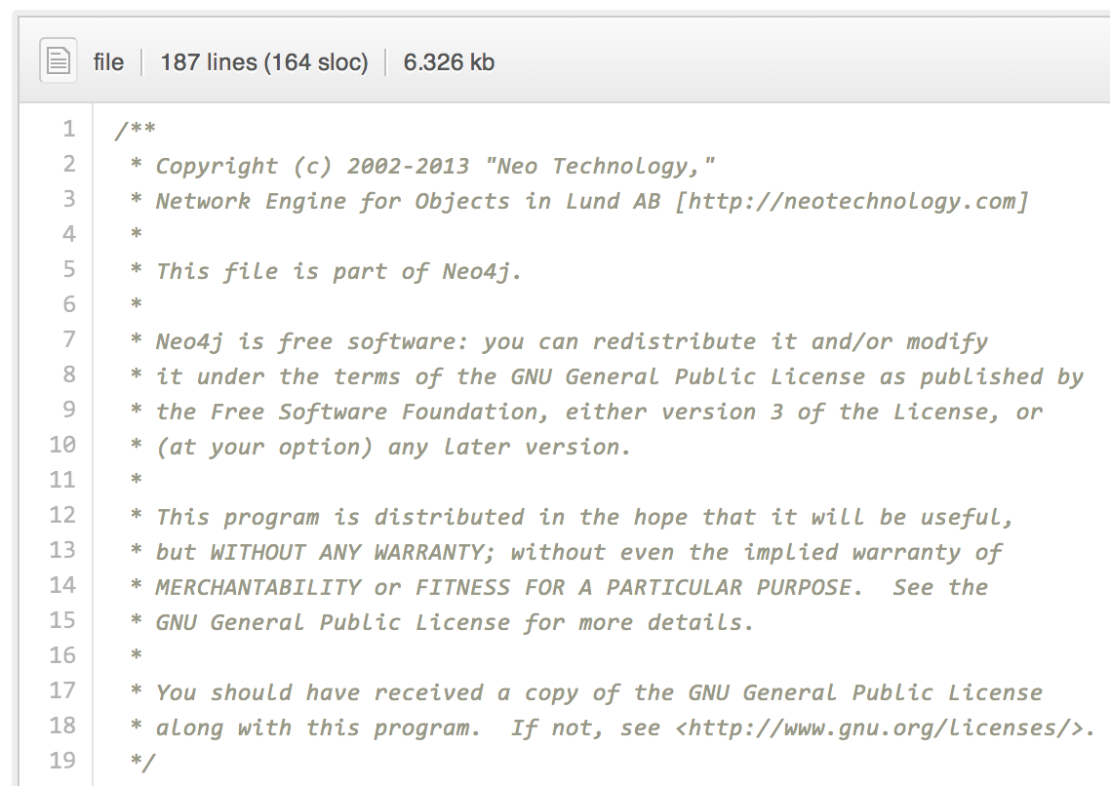
Neo4j History
Neo4j is open source: github.com/neo4j/neo4j
Line 2: Neo4j History
Line 3: “Official” meaning of the name
Line 7ff: Licensing
It’s more complicated.
We’ll get to that later.

Slide 30
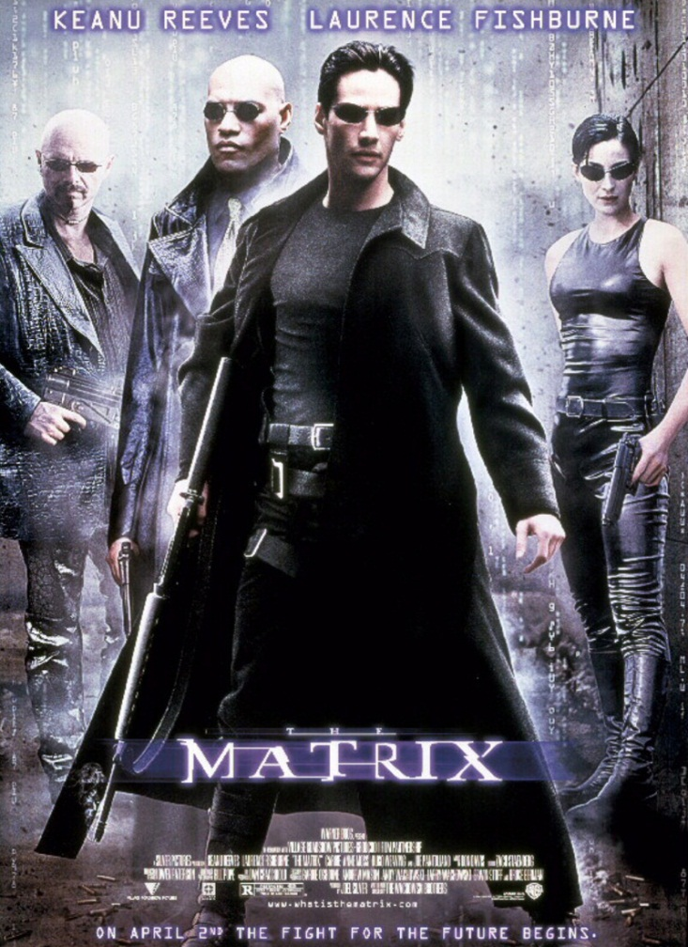
Neo4j History
Actual reason for the name
Written in Java (Cypher written in Scala)
Developed by Neo Technology (founded in Sweden)
© 2013 Warner Bros. Entertainment Inc.

Slide 31
Neo4j Operational Architecture
Embedded vs. Stand-alone
Neo4j embedded in application
Access through Java API
Neo4j as classic DB server
Access to Java API (Plugins)
Access to HTTP/REST API
App Logic
App Logic
HTTP
Cypher / Gremlin / REST
Java
Cypher
Gremlin
Java API
Cypher/Gremlin Plugin
App Logic (Plugins / Unmanaged Ext.)
Neo4j
Java
Cypher
Gremlin
Neo4j

Slide 32
Neo4j: Rules to Live By
Nodes can have 0 … n Labels
Relationships have 1 Label
Relationships have 1 Start Node and 1 End Node
Nodes and Relationships can have 0 … n Properties
Properties are Maps
Keys are Strings
Objects are (Primitives, Strings) or Arrays of (Primitives or Strings)
Don’t worry! These are enforced by the API!

Slide 33
Cypher Programming Language: Why?
Java
Requires low-level access
Too powerful / descriptive
Significant Overhead
Basic, no traversal support
Too descriptive
Generic, no support for Neo4j specifics
REST
Gremlin
Cypher
Solution to limitations

Slide 34
Cypher: Descriptive Graph Language
Key design principles:
Descriptive Language: Don’t say what to do, but how to do it
SQL-Likeness: Allow for an easy transition
Example: Return all employees of Accenture
Language Reference: http://docs.neo4j.org/refcard/
START acn=node:node_auto_index(company=”Accenture")
MATCH (acn)<-[:WORKS_AT]-(employee)
RETURN employee;

Slide 35
Cypher: Read-only Query Structure
START
[MATCH]
[WHERE]
RETURN [ORDER BY] [SKIP] [LIMIT]
START Start node(s) Node IDs, Ranges, Index Lookups
MATCH Pattern description Graph patterns
WHERE Predicate filter Property filters
RETURN Output selection Objects, Properties
ORDER BY Order definition
SKIP, LIMIT Range selection

Slide 36
Common Cypher Command Syntax
Match
Describes a pattern or relationship fo graph data
Neo4j traverses all paths within the graph which make up the pattern
Often used with WHERE to filter the collection
Where
Specifies the content of the query returned
Imposes conditions on the data within a potentially matching path and filters the data result.
Return
Defines what to include in a query result set, specified as a comma separated list
MATCH (director:Person)-[:DIRECTED]->(movie)
WHERE director.name = "Steven Spielberg“
RETURN movie.title
Returns the movie title of all movies directed by Stephen Spielberg

Slide 37
Neo4j APIs
Java
graphDb.getNodeById(3);
GET http://localhost:7474/db/data/node/3
REST
Cypher
START n=node(3)
RETURN n
g.V(3);
Gremlin

Slide 38
Java API: Simple Transaction
GraphDatabaseService graphDb = new ImpermanentGraphDatabase(); | Initiate a temporary, embedded graph database. Great for (unit) testing!
Transaction tx = graphDb.beginTx(); try { | Start a new transaction Warning: This is thread-global!
Node c = graphDb.createNode(); c.setProperty(“name”, “ETI”); c.setProperty(“type”, “Community”); | Do something fun… We’re creating a new node and adding two properties.
tx.success(); } finally { tx.finish(); } | Finish the transaction. Call Transaction.finish() in the finally block. If Transaction.success() has been called before, a commit is made. Otherwise: rollback.
graphDb.shutdown(); | Shutdown the graph database.

Slide 39
Which API to Use?
Political answer: (Neo4j) -[ :♥ ] -> Cypher
Pragmatic answer:
Java
Embedded development, high performance access, batches
Cypher
Reusable Queries, remote execution, complex traversals
REST
Quick command line (e.g. curl) access, simple extensions / lookups
Gremlin
For expert users. More on that later.

Slide 40
Neo4j Data Architecture: Overview
Memory Mapping
Java Heap
Nodes + Primitives
Properties
Data
Nodes + Relationships + Properties
Arrays
Relationships +
Primitives
Strings
Neo4j + Libs
Lucene
Java
Memory
Disk
Nodes + Primitives
Properties
Relationship Types
Node
Auto Index
Manual Index A
Manual Index B
Arrays
Relationships +
Primitives
Relationship
Auto Index
Manual Index C
Strings
…
Graph Index

Slide 41
Neo4j Data Architecture: Rules
Balance your graph model
Too much graph: Hard to maintain, traversal complexity Neo4j-specific: RelType Store limited
Too many properties: Hard to traverse, difficult to extend, less flexibility
Avoid the index
Lookups are expensive (entry nodes!)
Get SSDs
Watch your memory
Memory = Mapped Store + JVM Heap
NEVER forget about garbage collection
Be careful with memory-intensive tasks (batches)

Slide 42
Neo4j Operational Architecture: Benefits
High Importance
No Overhead
Direct access via JAVA POJOs
No HTTP overhead
Dedicated Memory
Safer JVM
Clustering
Works also in embedded mode, but well…
Extensions
RESTful APIs
Process Control
Control the DB process
Use different data stores
Embedded Stand-alone
Low Importance

Slide 43
Neo4j Licensing
GPL
AGPL
AGPL
Community Advanced Enterprise
HA +
Clustering
+ more support
Mgmt Console + support
Mgmt Console + support
Basics
Basics
Basics

Slide 44
Beyond Neo4j

Slide 45
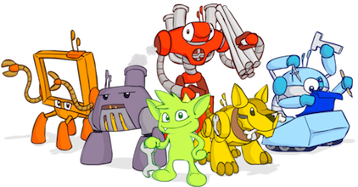
The Blueprints API to Work with Graph DBs
Pipes: Data-flow framework
Frames: An object-graph mapping
Blueprints: Property Graph Interface
Furnace: Graph algorithms package
Source: http://tinkerpop.com
Rexster: A graph server
Gremlin: A graph traversal language

Slide 46
Scalability: An Issue for Graphs
CAP Theorem:
Partition tolerance
Graphs not
out-of-the-box
partition-tolerant!
Graphs are limited in scalability: consider their use carefully before committing to a solution.
Consistency
Availability

Slide 47
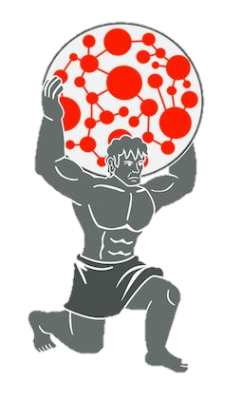
Additional Graph Database: Titan
Open source and available for download on Github, enterprise version and enterprise support now provided by Datastax
Built for scalability – can be deployed across multiple data centers
Transactional database that can query graphs composed of vertices and edges stored in a multi instance cluster
Integrates with other big data technologies: Cassndra, Hbase, Spark and Hadoop
Supports enhanced search capabilities via Solr, Lucene and ElasticSearch
Can be difficult to initially set up and requires a lot of configuration management, resources to build products on Titan are also very limited
More information and repo:
https://github.com/thinkaurelius/titan

Slide 48
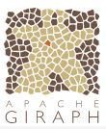
Additional Graph Database: Apache Giraph
Entirely open source, developed and maintained in conjunction with the Apache community
Built for large graph searches on Internet data distributed over several data centers and between different geographies
Computation runs as Hadoop jobs – performance may be hindered by traditional MapReduce and Spark limitations
Utilizes master-slave architecture – vertices or edges are assigned to worker nodes while master vertices assign and coordinate the work
Query pattern: load graph from disk, distribute vertices to workers, synchronize messages to workers and compute aggregates, write back results and delete intermediate data
Currently used at Facebook to hold information about users relationships and related entities
More information and repo:
http://giraph.apache.org/

Slide 49
Where to Get Help (External)?
Documentation http://docs.neo4j.org/
StackOverflow http://stackoverflow.com/questions/tagged/neo4j
Google Groups http://groups.google.com/group/neo4j
Read the source code https://github.com/neo4j/neo4j/
Learn Cypher http://www.neo4j.org/learn/cypher
Cypher Cheat Sheet http://docs.neo4j.org/refcard/1.9/

Slide 50
Lab: Neo4J

Slide 51
Neo4J Lab
The exercise walks you through
Installing Neo4J and loading the test-data
Run the example
Work in the Neo4J Console with Cypher query language to answer questions
You’ll experience how powerful the graph is as a data model
Find out how the code integrates with Cypher query language through Neo4J’s REST Interface
Learn to do your own complex queries on the Neo4J Console and then submit descriptions and Screenshots

